Slide 1


Identifying ACT & SAT Scores for Students from Low-income Families 2019
Brandie Hatch

Slide 2


Brandie Hatch
Data Scientist and Learning Specialist
M. Ed. Information Science and Learning Technologies
http://brandiehatch.com/
https://www.linkedin.com/in/brandiehatch/
Passionate about learning and food security.
Notes:
Presentation will be geared towards grant program and state education budget decision makers for grant eligibility determination and program funding.

Slide 3
Problem
Identify school districts with the most participants in the Free or Reduced-Priced Meal (FRPM) program.
Compare to district twelfth grader’s scores on the ACT and SAT.
We would like to confirm our hypothesis that students in low-income school districts are not meeting/exceeding the benchmark for SAT Math, Evidence-Based Reading & Writing (ERW), and ACT composite scores (score of 21 or more).
Provide findings to Title I program leaders so they can determine funding or grant eligibility.
These grants and funding sources could help improve ACT and SAT scores of children from low-income families to help ensure that all children meet challenging state academic standards.
Notes:
This project aims to identify the districts with the most Free and Reduced-Priced Meal (FRPM) program participation and the district twelfth grader’s aggregate scores on the ACT and SAT so that Title I program leaders can determine funding or grant eligibility. These grants and funding could help improve ACT and SAT scores of children from low-income families to help ensure that all children meet challenging state academic standards.
Project hypothesis: students in low-income school districts are not meeting/exceeding the benchmark for SAT Math, Evidence-Based Reading & Writing (ERW), and ACT composite scores. This project aims to explore a possible correlation between the districts with the most Free and Reduced-Priced Meal participation and their scores on the ACT and SAT so that Title I program leaders can determine funding or grant eligibility. These grants and funding sources could help improve ACT and SAT scores of children from low-income families to help ensure that all children meet challenging state academic standards.

Slide 4


Free and Reduced Price Meals
Title I, Part A of the Elementary and Secondary Education Act:
provides financial assistance to local educational agencies and schools with high numbers or high percentages of children from low-income families
to help ensure that all children meet challenging state academic standards
Notes:
Is often used as an indicator of low-income status for the students and families.
Title I, Part A of the Elementary and Secondary Education Act provides financial assistance to local educational agencies and schools with high numbers or high percentages of children from low-income families to help ensure that all children meet challenging state academic standards.

Slide 5
Student Eligibility for FRPM
Free Meals
Family income below 130% of the poverty level
Reduced Price Meals
Family income 130-185% of poverty level
Direct Certification
Free meals if household receives federal food security benefits
2019 California Poverty Level: $35,600 per year for a family of four
Notes:
Supplemental Nutrition Assistance Program (SNAP),
Temporary Assistance for Needy Families (TANF),
Food Distribution Program on Indian Reservations (FDPIR)
children who are:
Migrant
Homeless
In foster care

Slide 6
Healthy, Hunger-Free Kids Act 2010
The Healthy, Hunger-Free Kids Act 2010 (HHFKA) increased food access for schools in low-income areas.
All students in low-income areas are provided free meals.
Low-income area schools are certified as eligible if 95% of families receive Supplemental Nutrition Assistance Program (SNAP) benefits.
NOTE: The HHFKA limits the usefulness of the data provided by California.
Notes:
NOTE: These schools no longer count students who qualify for FRPM since all students are provided a free lunch. They may report all students as eligible for FRPM regardless of economic status, since all students are provided free meals.

Slide 7
ACT and SAT
Exams Goal: to gauge readiness for college
Number of Students Who Took Exam:
ACT: 1.78 million
SAT: 2.2 million
Cost for exams:
ACT $50.50 - $67.00 (with writing)
SAT $47.50 - $64.50 (with essay)
Critics of standardized tests say the tests create disadvantages for minority and low-income college applicants, as many wealthier students pay for pricey preparation courses that help to increase their scores — and chances of getting into better universities.
- Cal State says no need for SAT, ACT 2022
Notes:
Both exams are used to gauge readiness for college.
Class of 2019 exams:
ACT: 1.78 million students
SAT: 2.2 million students
Cost for exams:
ACT $50.50 - $67.00 (with writing)
SAT $47.50 - $64.50 (with essay)

Slide 8
Investigative Process
SAT
ACT
FRPM
Low-income Student Scores per School District
Utilizing data from the state of California:
2019 ACT and SAT scores
Free or Reduced-Price Meals (FRPM) School-level data, 2018-19 school year
Comparing the FRPM eligible students K-12 data with the ACT and SAT scores based on School Codes.

Slide 9
Visualization

Slide 10
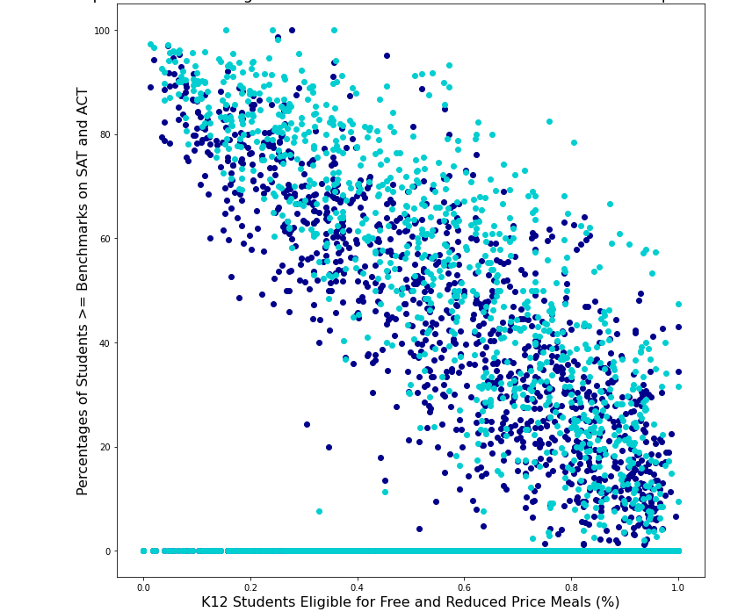

Slide 12
Primary Findings

Slide 13
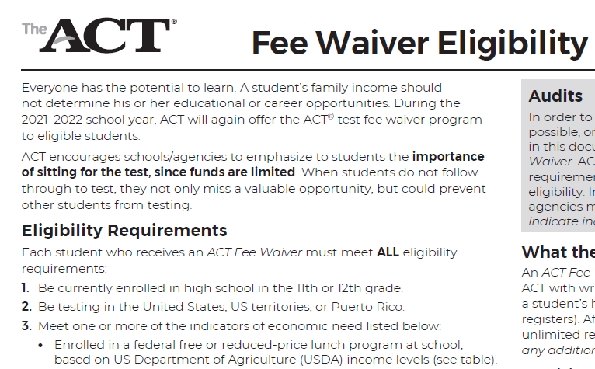
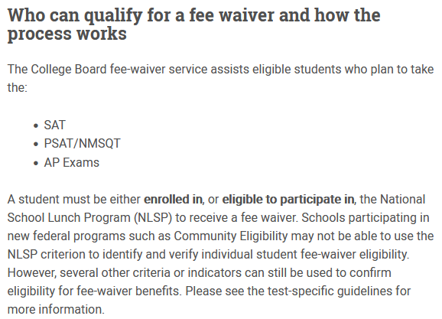

ACT and SAT Fee Waivers
Even with fee waivers, students may not be able to afford the preparatory practice tests which continues to put their peers at an advantage.
Notes:
Even with fee waivers, students may not be able to afford the preparatory practice tests which continues to put their peers at an advantage.

Slide 14
Conclusions and Recommendations

Slide 16
Sources
Income Eligibility Guidelines can be found from the Food and Nutrition Service Agency of the United States of America.
Free or Reduced-Price Meal School-level Data and Data Dictionary can be found on the California Department of Education website.
U.S. Department of Education Title I, Part A website: https://www2.ed.gov/programs/titleiparta/index.html
National Center for Education Statistics: https://nces.ed.gov/blogs/nces/post/understanding-school-lunch-eligibility-in-the-common-core-of-data
No Kid Hungry: Center for Best Practices: https://bestpractices.nokidhungry.org/

Slide 17
Questions
http://brandiehatch.com/
https://www.linkedin.com/in/brandiehatch/

